Slide 1
Artificial Intelligence Methods (AE2AIM)
Lec. 11- Revision
Dr. Xinan Chen (Room PMB442)
School of Computer Science
The University of Nottingham Ningbo, China
Email: xinan.chen@nottingham.edu.cn

Slide 2
Lecture 2 Heuristic
Combinatorial Optimization Problem
Examples
Definition of Heuristic
Constructive vs. Perturbative
Local Search
First Descent
Best Descent

Slide 3
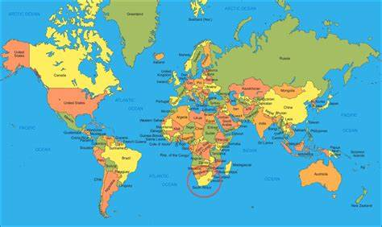
Combinatorial Problems – examples
Graph coloring problem
An assignment of labels traditionally called "colours" to elements of a graph subject to certain constraints.
A way of colouring the vertices of a graph such that no two adjacent vertices share the same colour; this is called a vertex colouring.
Applications:
Shared resource allocations
1
2
6
3
5
4

Slide 4
Heuristics
A heuristic is a rule of thumb method derived from human intuition.
A heuristic is a search method which seeks good, i.e. near-optimal solutions, at a reasonable cost without being able to guarantee optimality.
Good for solving ill-structured problems, or complex well-structured problems (large-scale combinatorial problems that have many candidate solutions to explore)
Notes:
So what is heuristic? A heuristic is a rule of thumb. Every of us uses heuristics every day except we don’t call it explicitly.
It is a search method that seeks good quality or near-optimal soutions at a resonable cost with out being able to guarantee optimality.

Slide 5
Graph Coloring Heuristics
Saturation Degree
Degree of a vertex: number of edges connected to that vertex.
Saturation degree of a vertex: number of differently colours to which it is adjacent.
Can we use saturation degree in a heuristic to construct a solution to a graph colouring problem?
1
2
Example:
4
6
3
5
4
1
2
Example:
2
6
3
5
4

Slide 6
Graph Coloring Heuristics
Max Saturation Degree First
Step 1. Arrange the vertices in decreasing order of their degree.
Step 2. Colour a vertex of maximal degree with colour #1.
Step 3. Choose an uncoloured vertex with maximal saturation degree.
If there is a tie choose any one of the vertices
with maximal degree in the uncoloured subgraph
Step 4. Colour the selected vertex using the colour with the lowest possible number (#)
Step 5. If all vertex are coloured then STOP
else go to step 3.
color1
color2
color3
color4
1
2
6
3
5
4

Slide 7
Examples – Heuristics for TSP
The nearest neighbour (NN) algorithm
Constructive (Deterministic and Systematic)
Pairwise exchange (2-opt), or Lin–Kernighan heuristics
Perturbative (Stochastic and Local Search)
Notes:
The pairwise exchange or '2-opt' technique involves iteratively removing two edges and replacing these with two different edges that reconnect the fragments created by edge removal into a new and shorter tour. This is a special case of the k-opt method. Note that the label 'Lin–Kernighan' is an often heard misnomer for 2-opt. Lin–Kernighan is actually a more general method.

Slide 8
The nearest neighbour (NN) algorithm
<city2, city1, city4, city3> : 26
After the choice of the last city, algorithm terminates
city2
4
city1
10
5
city4
city3
7

Slide 9
Improving upon simple heuristics
<c2,c1,c4,c5,c3,c2> : 33
Remove two edges and replace them with two different edges, reconnecting the fragments into a new and shorter tour.
city2
4
city1
10
<c2,c1,c5,c4,c3,c2> : 31
5
6
7
city4
city3
4
10
city5
How many possible pairwise exchanges are there in total?
How can each neighbouring solution be evaluated efficiently?

Slide 10
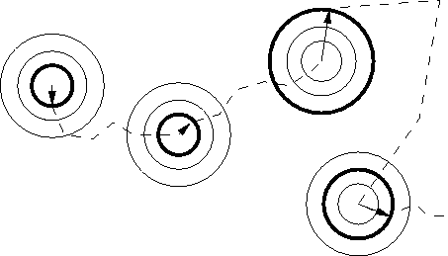
Local Search Methods
Local search is an iterative procedure to continuously improve the current solution by evaluating only solutions that are close (similar) to the current solutions.
One or more neighbourhoods are defined, each of which is a subset of the entire solution space.
Common strategies
First descent/ascent
Best descent/ascent
Solution Space

Slide 11
Lecture 3 Simulated Annealing
Basic concept
Real annealing
Temperature based
Whether to accept the solution
δ <0 or p = exp(-δ /t)> r
How to update the temperature

Slide 12
SA v.s. Local Search
Local Search
SA
if(delta >0)
{
new_sln->objective =
sln.objective + delta ;
new_sln->cap_left =
new_sln->cap_left +
v[item1]-v[item2];
return new_sln;
}
else //restore
{
new_sln->x[item1] = 1;
new_sln->x[item2]=0;
}//endelse
}//endif
}//endfor
}//endif
}//endfor
return NULL;
}
Compared to hill climbing the main difference is that SA allows downwards steps
Simulated annealing also differs from hill climbing in that a move is selected at random and then decides whether to accept it
In SA better moves are always accepted. Worse moves are not.

Slide 13
SA Algorithm (for minimizing)
Create an initial solution s₀ (often by a greedy heuristic);
Set parameters: starting temperature: t_{s}; stopping temperature: t_{f.} , and a cooling schedule: t = s(t), set current solution s=s₀ and number of repetitions at each temperature, nrep. Define neighbourhood N(s)
while (t>t_{f} && n < K)
while(rep< nrep)
s’=random(N(s)); rep++; r=random(0,1);
δ=f(s’)-f(s);
if (δ <0 || p = exp(-δ /t)> r) set s=s’; endif
update the best solution found so far, s*
endwhile
Update temperature t=s(t). n++; rep=0;
endwhile
return s*

Slide 14
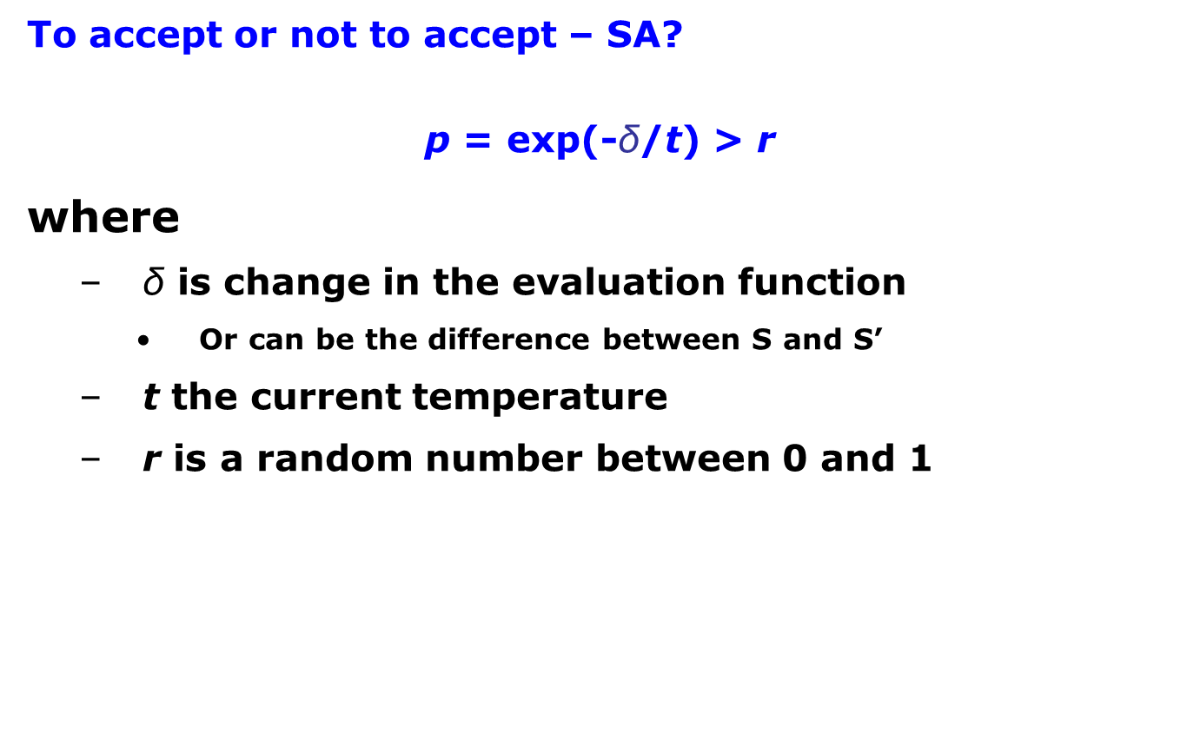
Simulated Annealing
To accept or not to accept – SA?
p = exp(-$\text{δ}$/t) > r
where
δ is change in the evaluation function
Or can be the difference between S and S’
t the current temperature
r is a random number between 0 and 1

Slide 15
Lecture 4 Tabu Search and VNS
Basic concept
Tabu search
Mamery based
Tabu list
Tabu tenure
Variable Neighborhood Search (VNS)
Motivation -> solution can not be reached
Basic conponnents
Acceptance cretieria

Slide 16
Tabu Search
Accepts non-improving solutions deterministically in order to escape from local optima (where all the neighbouring solutions are non-improving) by guiding a steepest descent local search (or steepest ascent hill climbing ) algorithm;
Uses of memory to:
prevent the search from revisiting previously visited solutions;
explore the unvisited areas of the solution space;

Slide 17
Elements of Tabu Search
Tabu_list (short term memory): to record a limited number of attributes of solutions (moves, selections, assignments, etc.) to be discouraged in order to prevent revisiting a visited solution;
Tabu_tenure: number of iterations a tabu move is considered to remain tabu;
Aspiration criteria: accepting an improving solution even if generated by a tabu move
Similar to SA in always accepting improving solutions, but accepting non-improving ones when there is no improving solution in the neighbourhood;

Slide 18
TS Examples – TSP
Best descent LS
<c1, c2, c4, c5, c3>, obj: 35
Iter 1:
Set of neigbouring solutions:
<c2, c1, c4, c5, c3>, obj: 33
<c4, c2, c1, c5, c3>, obj: 33
<c5, c2, c4, c1, c3>, obj: 40
<c3, c2, c4, c5, c1>, obj: 37
<c1, c4, c2, c5, c3>, obj: 40
<c1, c5, c4, c2, c3>, obj: 37
<c1, c3, c4, c5, c2>, obj: 34
<c1, c2, c5, c4, c3>, obj: 34
<c1, c2, c4, c3, c5>, obj: 33
Iter 2:
<c2, c4, c1, c5, c3>, obj=37
<c1, c2, c4, c5, c3>, obj=35 (tabu!)
<c5, c2, c1, c4, c3>, obj=34
<c3, c2, c1, c5, c4>, obj=31
<c4, c1, c2, c5, c3>, obj=35
…. ….
<c4, c2, c1, c3, c5>, obj=35
Neighbourhood swap(c_{i},c_{j})
Tabulist
indx | entry
0 | (c1,c4)
1 | (c3,c4)
2
3
Tabu tenure tten: number of iterations a given tabu element remain tabu!
Often implemented as a list of fixed length with FIFO policy.

Slide 19
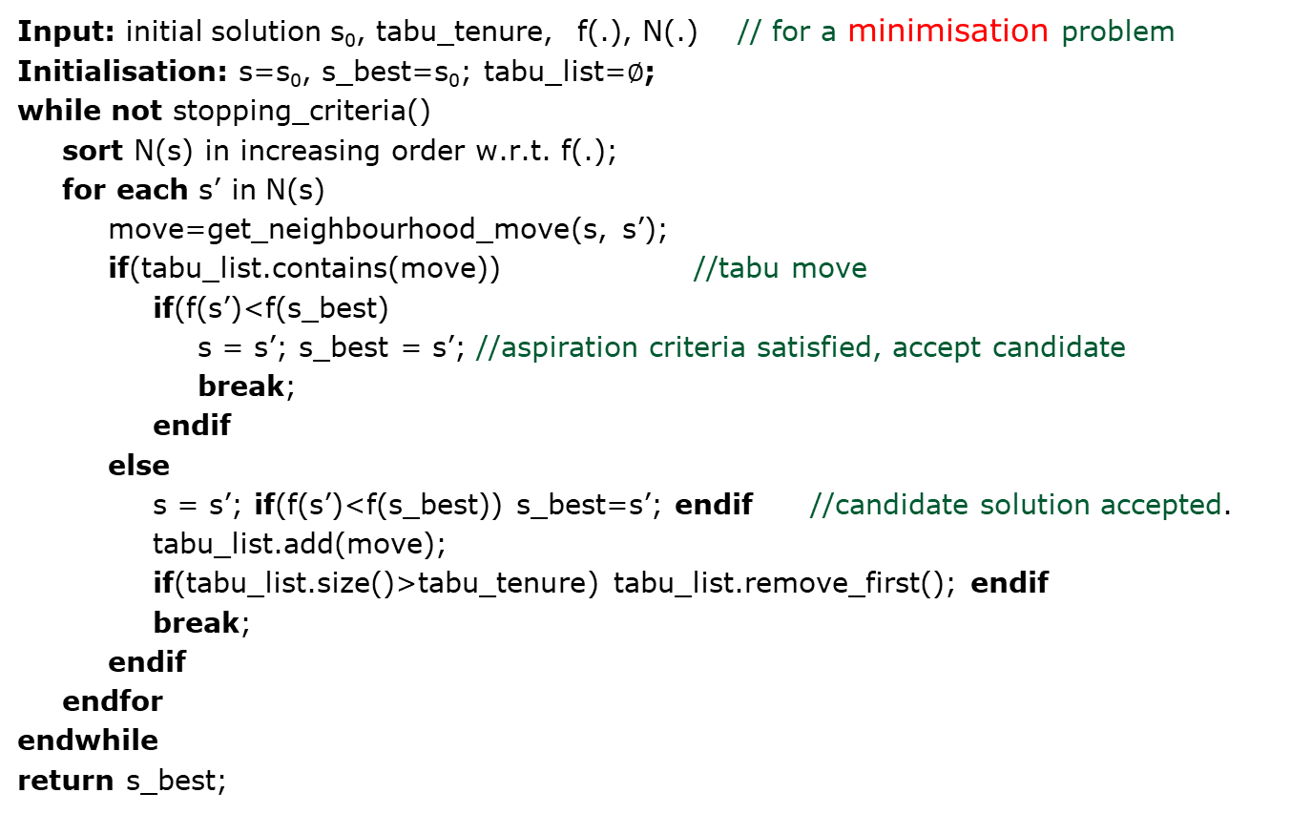
Basic Tabu Search Pseudocode
Input: initial solution s₀, tabu_tenure, f(.), N(.) // for a minimisation problem
Initialisation: s=s₀, s_best=s₀; tabu_list=$∅$;
while not stopping_criteria()
sort N(s) in increasing order w.r.t. f(.);
for each s’ in N(s)
move=get_neighbourhood_move(s, s’);
if(tabu_list.contains(move)) //tabu move
if(f(s’)<f(s_best)
s = s’; s_best = s’; //aspiration criteria satisfied, accept candidate
break;
endif
else
s = s’; if(f(s’)<f(s_best)) s_best=s’; endif //candidate solution accepted.
tabu_list.add(move);
if(tabu_list.size()>tabu_tenure) tabu_list.remove_first(); endif
break;
endif
endfor
endwhile
return s_best;

Slide 20
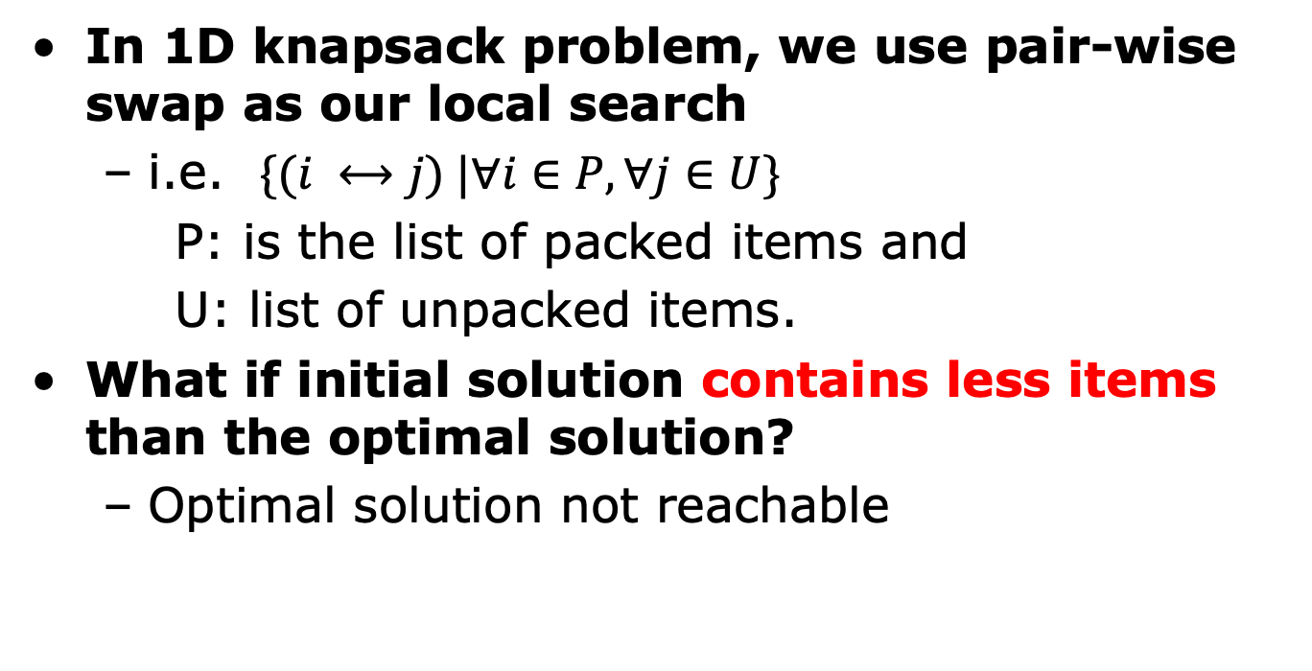
VNS - Motivation Reachability of Search Space
In 1D knapsack problem, we use pair-wise swap as our local search
i.e. $\{(i ⟷j) |∀i∈P, ∀j∈U\}$
P: is the list of packed items and
U: list of unpacked items.
What if initial solution contains less items than the optimal solution?
Optimal solution not reachable

Slide 21
Basic Notions of VNS
Systematic change of the neighbourhood in search
Assumes a set of neighborhood with different sizes.
Change of search trajectory
Preference is given to small sized neighbourhood.
Exploration of increasingly distant neighbourhood if no progress
Accept a solution if and only if there is an improvement
Solution Space

Slide 22
Variable Neighbourhood Search Pseudocode
Input: initial solution s₀, f(.), <N₁(.), …,N_{k}(.)> // for a minimisation problem
Initialisation: s=s₀, s_best=s₀, i=1; // i is neighbourhood index
while not stopping_criteria()
//intensification stage (neighbourhood search)
while (i <=k)
s’=best_descent(N_{i}(s)); //local search
if f(s’) < f(s)
s=s’;
i=1; //switch to the first neighbourhood
continue;
else i++; //next neighbourhood
endif
endwhile
if f(s) < f(s_best) s_best =s; endif //update best solution
s=shaking(s); //diversification stage (shaking) new start point
endwhile
return s_best;

Slide 23
Lecture 5 Genetic Algorithm
Basic concept
Parents selection
Tournament Selection
Roulette Wheel Selection
Evolving strategy
Crossover
1 point crossover
2 point crossover
Uniform crossover
Mutation

Slide 24
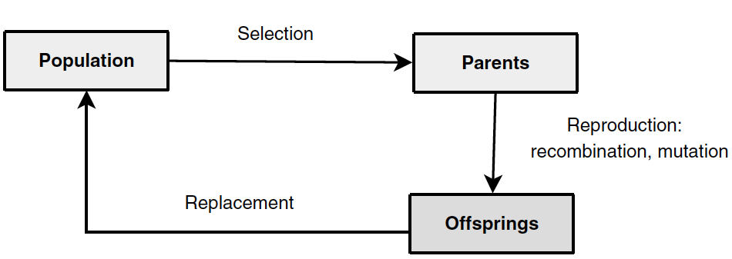
General Components of EAs

Slide 25
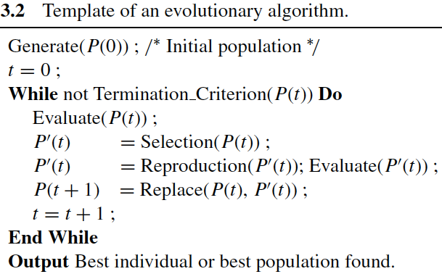
Pseudo Code of a Basic GA

Slide 26
Selection: Tournament Selection
Encoding
Selection strategy decides which individuals have chance to reproduce. Common methods include roulette wheel selection, tournament selection, rank selection, truncation selection, Boltzmann selection, etc.
Tournament selection method involves running a number of "tournaments" among randomly chosen individuals (of tourm. size) selecting the one with best fitness at the end
This process is repeated for selecting each parent to be recombined
Initialisation
Selection
Reprouction
Replacement
Fitness functin
Stopping Criteria

Slide 27
Example – tourm. size = 3, first parent
Assume the method chooses randomly chosen individual#1, #2 and #3 at random, then individual#1 with the fitness of 13 is returned as the first parent
0
1
1
0
1
13
0
0
0
1
0
2
0
1
0
0
1
9
1
0
1
0
1
21
Population

Slide 28
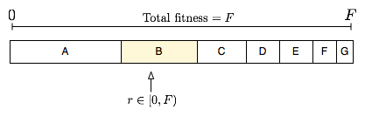
Selection: Roulette Wheel Selection
Encoding
Fitness level is used to associate a probability (prob_{i}) of selection with each individual chromosome (i)
While candidate solutions with a higher fitness will be less likely to be eliminated, there is still a chance that they may be
Initialisation
Selection
Reprouction
Replacement
Maximisation problem
Fitness functin
Stopping Criteria
minimisation problem

Slide 29
Recombination/Crossover
Encoding
Selected pairs/mates (parents) are recombined to form new individuals (children/offspring) – exchange of genetic material
Crossover is applied with a crossover probability p_{c} which in general is chosen close to 1.0
One Point Crossover (1PTX)
Generate a random number in [0,1), if it is smaller than a crossover probability p_{c} Then
Select a random crossover site in [1,choromosome length]
Split individuals at the selected site
Exchange segments between pairs to form two new individuals
Else
Copy the individuals as new individuals
Initialisation
Selection
Reproduction
Replacement
Fitness function
Stopping Criteria

Slide 30
Example VI
Randomly determined crossover points
0
0
1
0
1
0
1
1
0
1
1
1
1
0
1
Exchange genetic material
1
0
1
0
1
1
0
1
0
1
1
0
1
0
1
0
1
0
0
1
0
1
0
0
1
Offspring

Slide 31
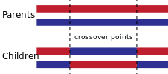
Other Crossover Operators
2 Point Crossover (2PTX)
K-point Crossover
Uniform Crossover (UX)
The uniform crossover considers each bit in the parent strings for exchange with a probability of 0.5.
0
0
1
0
1
0
1
1
0
0
Random Number
0.23 0.76 0.15 0.34 0.91
1
1
1
0
0
1
0
1
0
1

Slide 32
Mutation
Any offspring might be exposed to mutation
Loop through all the alleles of all the individuals one by one, and if that allele is selected for mutation with a given probability p_{m}, you can either change it by a small amount or replace it with a new value
For binary representation mutation corresponds to flipping a selected gene value (0→1, 1→0)
Mutation provides diversity and allows GA to investigate different regions of the search space (escaping)
Mutation rate is typically chosen to be very small (0.001, 0.1). Choosing p_{m} as (1/chromosome length) implies on average a single gene will be mutated for an individual.

Slide 33
Example VII
A loop is performed on each individual
If a random value in [0,1) is < p_{m} =0.2 (1/5), then the allele value is flipped, otherwise kept same.
0.23 0.76 0.41 0.14 0.91
1
1
1
1
0
1
0.47 0.19 0.28 0.94 0.78
0
0
1
0
0
1

Slide 34
Lecture 6 Linear Programming
Matrix
Process of Linear Programming
Step 1: Determine Decision Variables
Step 2: Formulate Objective Function
Step 3: Formulate Constraints
Step 4: Solve the Problem
Solving methods
Graph based
Simplex
Branch-and-Bound

Slide 35
Formulate a LP
Step 1: Determine Decision Variables
x₁= The number of Aqua-Spas produced
x₂ = The number of Hydro-Lux produced
Step 2: Formulate Objective Function Max 350x₁ + 300x₂
Step 3: Formulate Constraints
x₁ + x₂ = 200
9x₁ + 6x₂ = 1,566
12x₁ + 16x₂ = 2,880

Slide 36
Solving LP Problems: A Graphical Approach
x₂
The best point in the feasible region is the optimal solution to the problem
250
objective function
200
350x₁ + 300x₂ = 35,000
150
optimal solution
350x₁ + 300x₂ =66,100
100
objective function
350x₁ + 300x₂ = 52,500
50
0
0
50
100
150
200
250
x₁

Slide 37
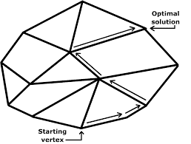
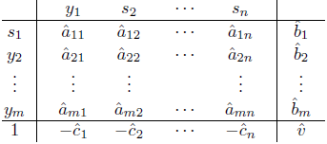
Algorithmic Approaches
Simplex method
It focuses on CPF solutions. In the worst case, it requires a number of steps that is exponential in the size of the problem.
However, it performs well in practice, visiting only a small fraction of the total number of vertices.

Slide 38
The essence of the Simplex method
x₂
CPF Solution | Its adjacent CPF Solutions
(0, 0) | (0, 180) and (174, 0)
(0, 180) | (0, 0) and (80, 120)
(80, 120) | (0, 180) and (122, 78)
(122, 78) | (80, 120) and (174, 0)
(174, 0) | (0, 0) and (122, 78)
250
200
(0, 180)
150
(80, 120)
Optimality test: If a CPF solution has no adjacent CPF solutions that are better (as measured by Z), then it must be an optimal solution.
100
(122, 78)
50
(0, 0)
(174, 0)
0
0
50
100
150
200
250
x₁
Corner-point feasible solutions (CPF solutions)
Notes:
For any linear programming problem with n decision variables, two CPF solutions are adjacent to each other if they share n – 1 constraint boundaries. The two adjacent CPF solutions are connected by a line segment referred to as an edge of the feasible region.

Slide 39
The essence of the Simplex method
x₂
Initialization: Choose (0, 0) as the initial CPF solu-tion to examine.
Optimality test: Conclude that (0, 0) is not an opti-mal solution (adjacent CPF solutions are better)
250
200
Iteration 1: Move to adjacent CPF solution, (174, 0)
Optimality test: Conclude that (174, 0) is not an optimal solution
(0, 180)
z = $54,000
150
(80, 120)
Iteration 2: Move to adjacent CPF solution, (122, 78)
Optimality test: Conclude that (122, 78) is an optimal solution, so stop
z = $64,000
100
(122, 78)
2
z = $66,100
50
0
(0, 0)
(174, 0)
z = $0
1
z = $60,900
0
0
50
100
150
200
250
x₁

Slide 40
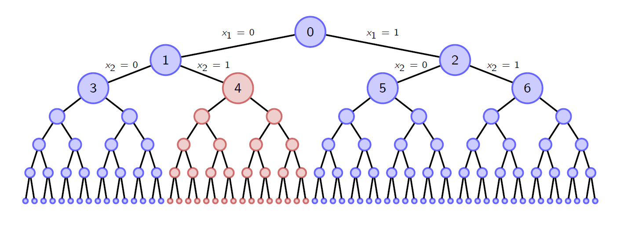
Solution Methods
Branch-and-Bound
Idea: enumerate all possible solutions systematically using a tree (branch). Stop branching from a node as soon as possible (e.g. suppose we look at node 4 and conclude none of its descendants can be optimal), thus we can eliminate 1/4 the solutions at once!

Slide 41
Lecture 7 Genetic Algorithm Extensions
Parameters
Parameter tuning
Evolutionary Algorithm features
Genetic Programming

Slide 42
Summary of EA & Parameter Tuning
Imulates natural evolution process
Some important decisions to make
Encoding/decoding, Selection method, Crossover/mutation, Replacement, etc.
Each stage has parameters. Main parameters are:
pop_size
num_of_gen
p_{c} , p_{m}
tourm_size
Parameter tuning & Implications…
Encoding
(Chromosome)
Decoding
initialisation
Population
Stop?
fitness
selection
Mating pool
Output
Crossover
Mutation
Children
replacement

Slide 43
EAs – Features
Avoid converging to local optima
Use exploration of the search space and exploitation of promising areas.
Reproduction focuses on high fitness individuals, thus exploiting (EXPLOITATION) the available fitness information.
Recombination and mutation perturb those individuals, providing general heuristics for EXPLORATION. Through recombination operators, reach better solutions by combining already found good solutions

Slide 44
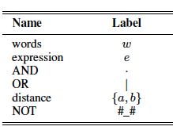
GP for RegEx Based Medical Text Classifier (3)
Solution encoding
GP Tree
GP Functions and Terminals

Slide 45
Lecture 8 ACO & PSO
Basic concepts
Ant Colony Optimisation (ACO)
Pheromone
Reinforce
Veperate
Particle Swarm Optimisation (PSO)
Personal best (pbest_{i})
Global best (gbest)
Velocity update

Slide 46
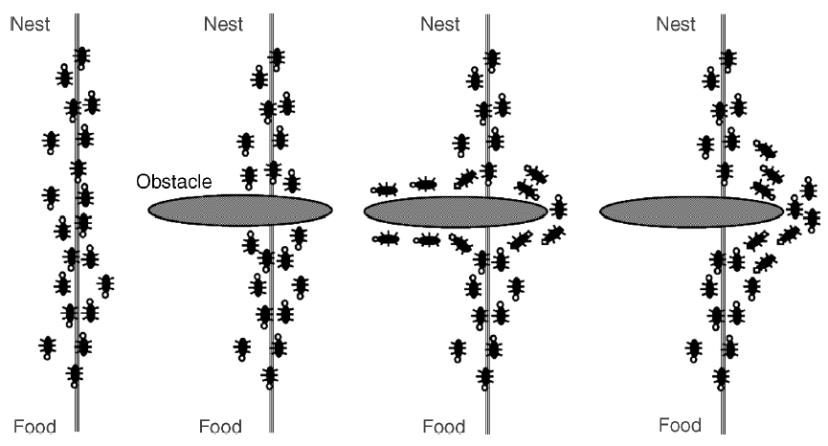
Ant Colony Optimisation
A metaheuritic approach that imitates the cooperative behaviour of real ants.
Pioneered by M. Dorigo.
M. Dorigo. Optimization, learning and natural algorithms. PhD thesis, Politecnico di Milano, Italy, 1992.
Ants share knowledge through traces of a chemical substance, called “pheromone”.
The larger the amount of pheromone on a particular path, the greater the probability that the ants will select the path.
The quantity of pheromone laid by each ant depends on the quality of the path (intensification).
Pheromone evaporates over time (diversification).

Slide 47
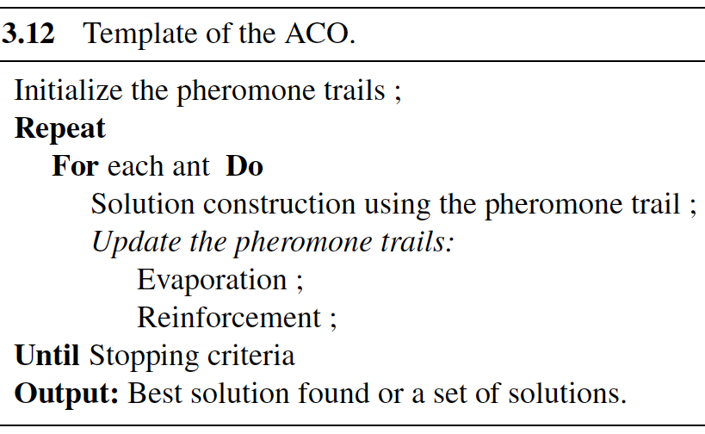
Template of ACO

Slide 48
Solution Construction
Solution construction is done by making use of
Pheromone trails: reflecting the acquired knowledge
Problem-dependent heuristic information
The construction process is stochastic

Slide 49
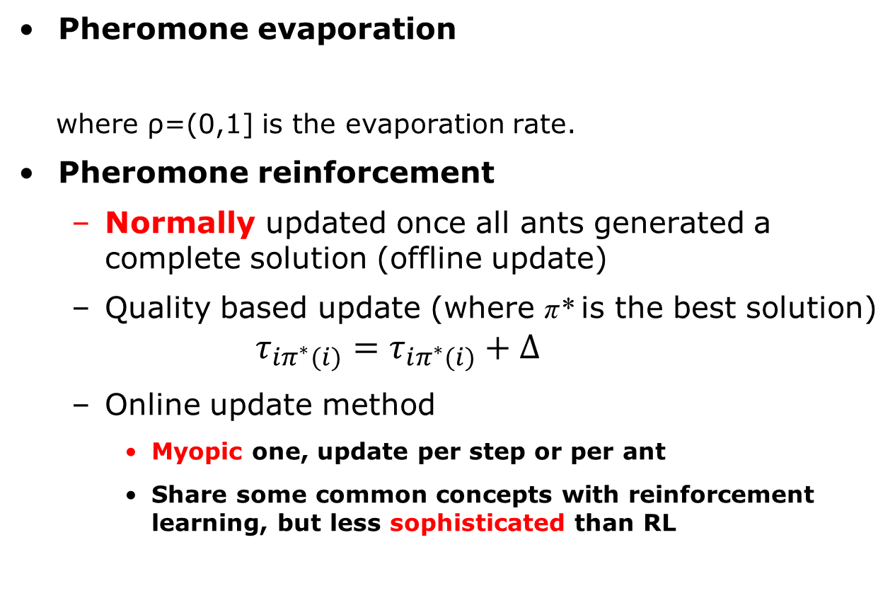
Pheromone Update
Pheromone evaporation
where ρ=(0,1] is the evaporation rate.
Pheromone reinforcement
Normally updated once all ants generated a complete solution (offline update)
Quality based update (where π* is the best solution)
$$τ_{iπ^{∗}(i)}=τ_{iπ^{∗}(i)}+∆$$
Online update method
Myopic one, update per step or per ant
Share some common concepts with reinforcement learning, but less sophisticated than RL

Slide 50
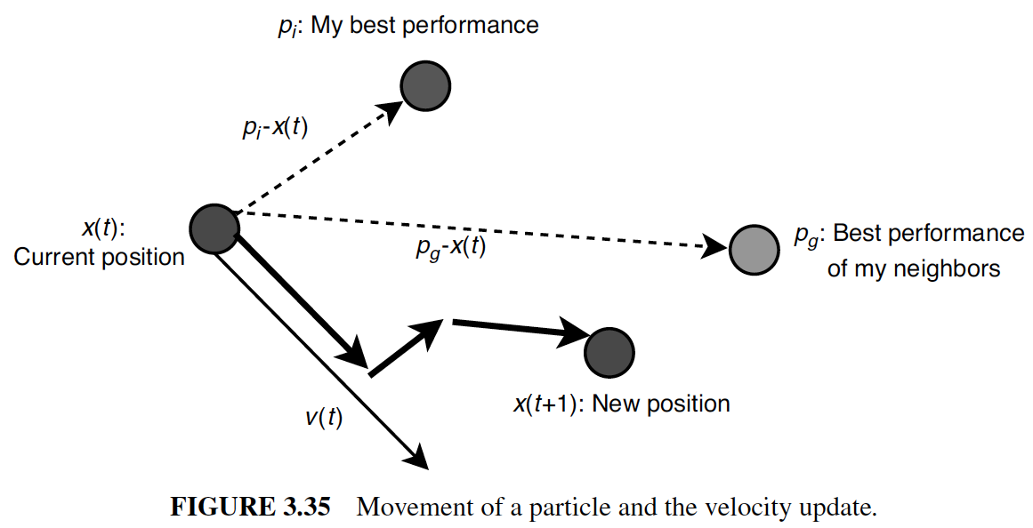
Movement of a Particle

Slide 51
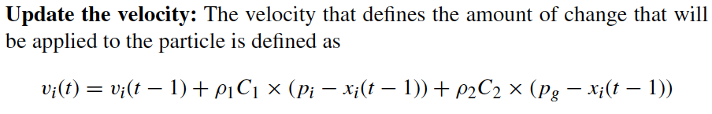
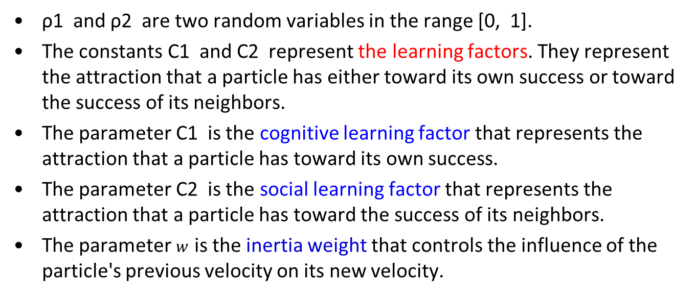
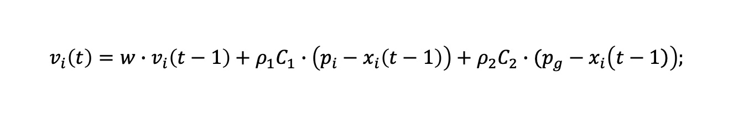
Velocity Update
$$v_{i}\left(t\right)=w∙v_{i}\left(t−1\right)+ρ_{1}C_{1}∙\left(p_{i}−x_{i}\left(t−1\right)\right)+ρ_{2}C_{2}∙(p_{g}−x_{i}\left(\left.t−1\right)\right);$$
ρ1 and ρ2 are two random variables in the range [0, 1].
The constants C1 and C2 represent the learning factors. They represent the attraction that a particle has either toward its own success or toward the success of its neighbors.
The parameter C1 is the cognitive learning factor that represents the attraction that a particle has toward its own success.
The parameter C2 is the social learning factor that represents the attraction that a particle has toward the success of its neighbors.
The parameter $w$ is the inertia weight that controls the influence of the particle's previous velocity on its new velocity.

Slide 52
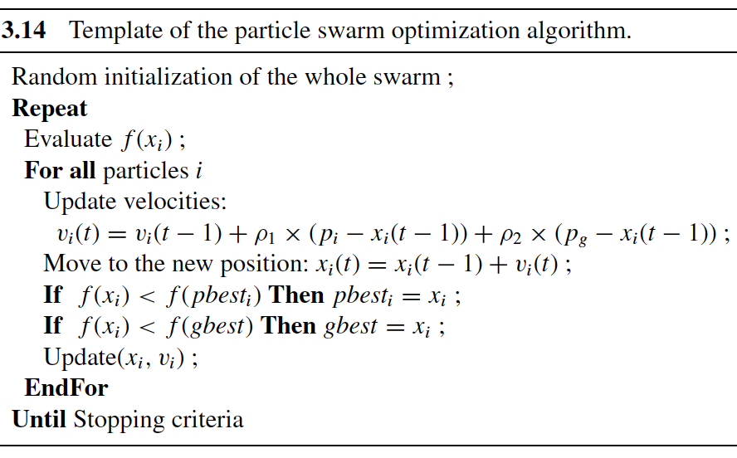
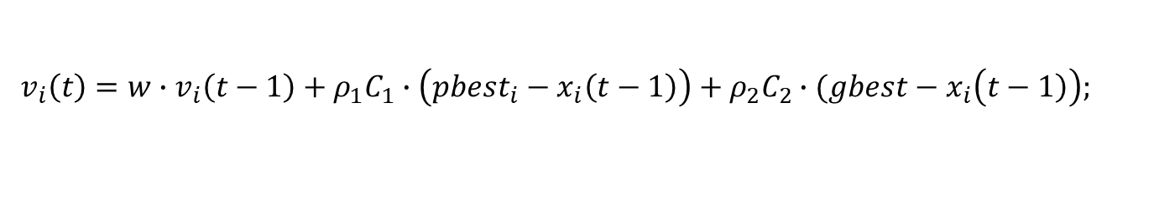
Template of PSO
$$v_{i}\left(t\right)=w∙v_{i}\left(t−1\right)+ρ_{1}C_{1}∙\left({pbest}_{i}−x_{i}\left(t−1\right)\right)+ρ_{2}C_{2}∙(gbest−x_{i}\left(\left.t−1\right)\right);$$

Slide 53
Lecture 9 Hyper-heuristic
Basic concept
Selection hyper-heuristics
Greedy Selection
Reinforcement Learning
ANO
Etc.
Generation hyper-heuristics
No free Lunch
Search space difference vs. Metaheuristics

Slide 54
No free lunch theorem
There are so many algorithms for optimization, so what is the best one?
Answer: NO
Reasons that we cannot answer this question
Complexity and diversity of real-world problems often mean that some problem are easier to solve,
whereas, others can be extremely difficult to solve
A single method that can cope with all type of problems is impossible.

Slide 55
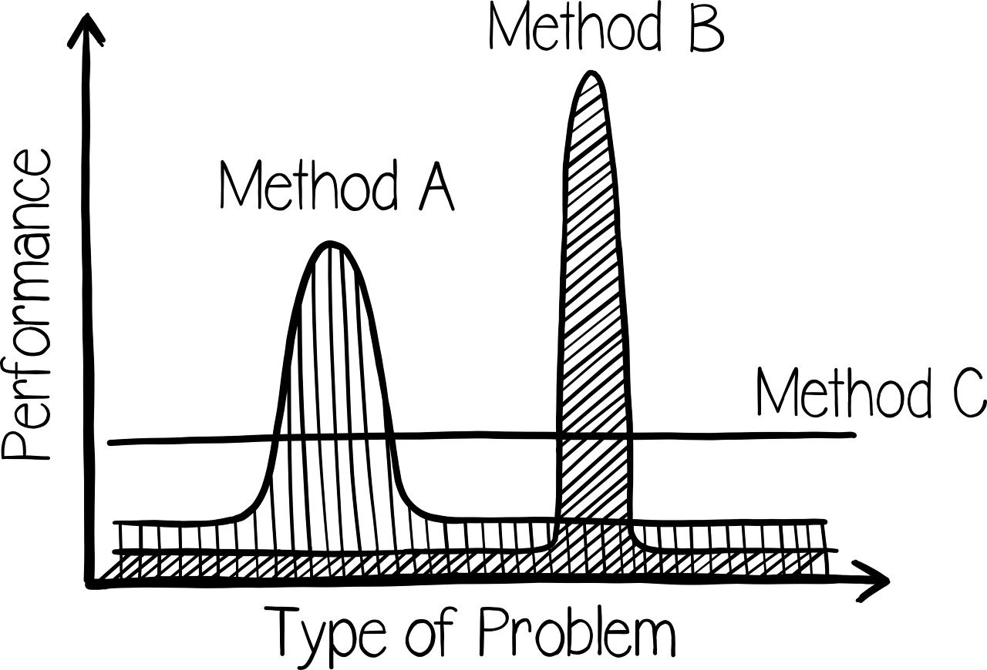
No free lunch theorem
No-free-lunch(NFL) theorem
There’s no one model that works for every problem (scenario)
Assumptions of a great model for one problem may not hold for another problem

Slide 56
Hyper-heuristics vs. Metaheuristics Different Search Spaces
Metaheuristics
Operate on the solution space
Hyper-heuristics
Operate on the heuristic space
Heuristic Space
Solution Space
Solution Space

Slide 57
Selection Hyper-heuristics
generate initial candidate solution p
while (termination criteria not satisfied){
select a heuristic (or subset of
heuristics) h from {H₁, ..., H_{n}}
generate a new solution (or solutions) s
by applying h to p
decide whether to accept s or not
if (s is accepted) then
p=s }
return p;

Slide 58
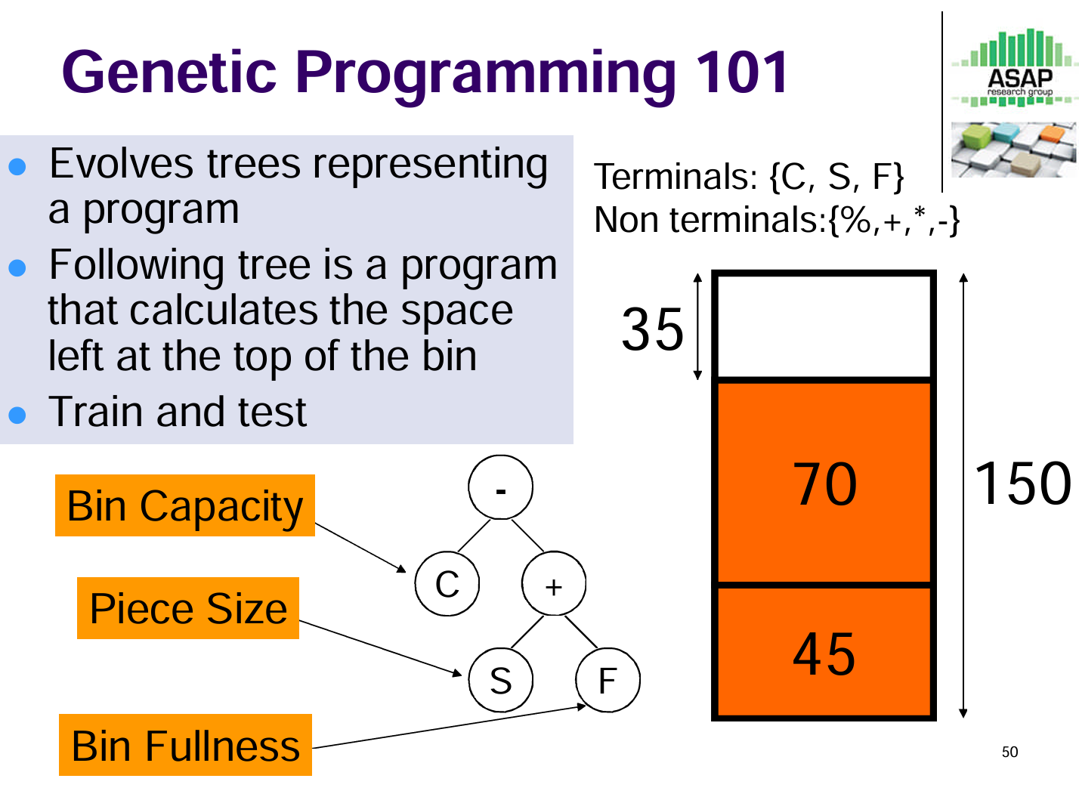
Case Study: GP Hyper-heuristic

Slide 59
Lecture 10 Multi-Objective Optimization
Why multiobjective
By nature, many real-life problems have multiple objectives
Objectives are conflict
Basic concepts
Pareto Set
Pareto front
Multi-Criteria Decision Making Strategies
Algorithms
NSGA-II
MOEA/D

Slide 60
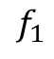
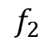
Pareto Optimal Solutions= Best Trade-off Candidates
Search Space
$$f_{2}$$
Feasible objective region
PF
PS
$$f_{1}$$
x is Pareto optimal if no other solution dominates it.
A (rational) decision maker doesn’t like non-Pareto optimal solutions.
Pareto set (PS)= the set of all Pareto optimal solutions in the x-space.
Pareto front (PF) = the image of the PS in the F-space.
Notes:
So, people are looking for the best trade-off among different objectives.
Best tradeoff solutions can be defined by Pareto optimality.

Slide 61




Strategies in Multi Criteria Decision Making
A-priori
A-posteriori
interactive
The final solution
A number of Pareto optimal solutions
The final solution
?

Slide 62
NSGA2-Flow Chart

Slide 63
MOEA/D=Decomposition + Collaboration
Decomposition (from traditional opt)
Decompose the task of approximating the PF into N subtasks. Each subproblem can be single objective or multiobjective.
Collaboration (from EC)
N agents (procedures) are used. Each agent is for a different subproblem.
These N subproblems are related to one another. N agents can solve these subproblems in a collaborative manner.

Slide 64
Problem Decomposition
Weighted Sum Approach
It works for convex PF.
Pareto optimal solution
Approximation of the PF
N single obj opt suproblems

Slide 65

The End of AIM
Any Suggestions?
About FYP.
SET Survey

